Slide 1

WEB DESIGNING (VOCATIONAL COURSE) HTML TAGS AND IT'S USES
SUBMITTED BY : RISHIKA R
REGISTER NO. : 21COAE046

Slide 2

HTML TAGS AND IT'S USES :
1. <HTML>. . . </HTML> : The entire HTML document
2. <HEAD> . . . </HEAD> : The head, or prologue, of the HTML
document
3. <BODY> . . . </BODY> : All the other content in the HTML
document
4. <TITLE> . . . </TITLE> : The title of the document
5. <H1> . . . </H1> : First-level heading large text size
6. <H2> . . . </H2> : Second-level heading
7. <H3> . . . </H3> : Third-level heading
8. <H4> . . . </H4> : Fourth-level heading
9.<H5> . . . </H5> : Fifth-level heading
10.<H6> . . . </H6> : Sixth-level heading small text size

Slide 3
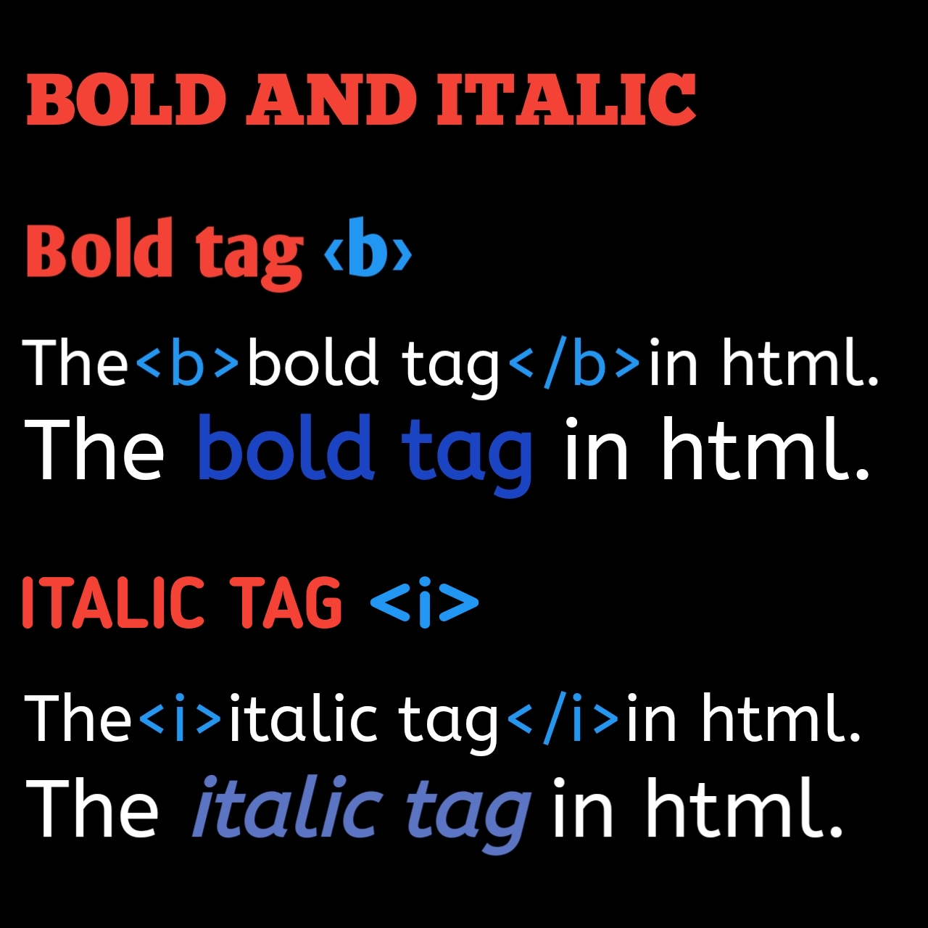
11. <P> . . . </P> : Paragraph Hitting a return in the HTML file
will not make a new paragraph when the file is viewed. You
need to use this tag to make a new paragraph.
12. <BR> : Line Break This tag will show a blank line.
13. <!> : COMMENTS This is used to create comments.
14. <HR> : Horizontal Rule Creates a horizontal line on the
page.
15. <B> . . . </B> : Bold Makes text bold
16. <I> . . . </I> : Italic Makes text italic
17. <U>. . . </U> : Text will be underlined
18. <A href=> . . . </A> : Link (A=Anchor) links the current
HTML file to another file.
19.<IMG SRC="image.gif"> : Inline Image Put the name of the
graphic in the quotes.
20. <UL>. . .</UL> : This tag is used to display items in bullets
21. <FORM>. . .</FORM> :This form is used to create a form in
HTML

Slide 4
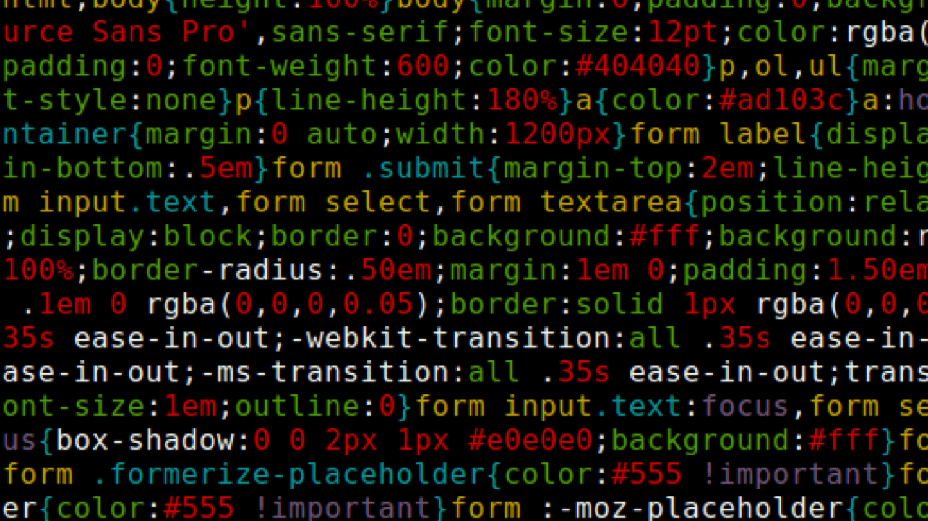
22. <MARK>. . .</MARK> : This tag is used to highlight the text in
HTML
23. <SUB>. . .</SUB> : This tag is used to create subscript in HTML
24. <SUP>. . .</SUP> : This tag is used to create superscript in HTML
25. <MARQUEE>. . .</MARQUEE> : A Piece of text or image can be
moved horizontally or vertically in HTML using this tag
26. <TABLE>. . .</TABLE> : This tag is used to create a table in
HTML
27. <TR>. . .</TR> : This tag defines table rows
28. <TH>. . .</TH> : This tag defines table column
29. <TD>. . .</TD> : This tag is used to specify the data in a cell
30. <CAPTION>. . .</CAPTION> : This tag defines title for the table
THANK YOU !
------------------------------------------------------------------------

